Slide 1

Instructor Notes
Ensure you update your contact information on the Title slide
This class is a combination of Lecture, Demo and Lab
Class duration is expected to be approximately 4 hours
All Demos and Labs are described in the slide Notes
File Student Modeling_PreClass.pbix does not have all DAX applied, and will be used by the students in Labs.
Save a copy of this file to add DAX and perform demos during class. It is easier to save a copy as in one demo, you will need to show “before and after” file sizes
File Instructor Complete Modeling.PBIX has all complete DAX and relationships applied. Use this file for Demos.
Answers to the Knowledge Checks can be found in the Appendix
Both PBIX files have a FullPath parameter which can be adjusted to the location of the source data file VanArsdel_Actuals.xlsx
Download and install Power BI Desktop:
Download and install Microsoft Power BI Desktop from: http://www.microsoft.com/en-us/download/details.aspx?id=45331
Version: 20170428
Notes:
Changes:
Removed all M and C notations for measures and calculated columns in the formulas and notes
Replaced “Advanced DAX” with “data modeling”

Slide 2

Instructor name
Title
Email
Version: March_2017
Notes:
Purpose of this presentation: Power BI Modelling
Target audience: Analysts, Report Builders

Slide 3
Prerequisites and Setup Steps
Internet connectivity: You must be connected to the internet
At minimum, a computer with 2-cores and 4GB RAM running one of the following version of Windows: Windows 7,
Windows 8, (64-bit preferred), Windows 8.1 or Windows 10 or Windows Server 2008 R2 or Windows Server 2012/R2
Microsoft Power BI Desktop requires Internet Explorer 9 or greater
Verify if you have 32bit or 64bit operating system to decide if you need to install the 32bit or 64bit applications.
Search for computer on your PC, right click properties for your computer
You will be able to identify if your operating system is 64 or 32 bit based on “system type” as shown below
Download and install Power BI Desktop: Download and install Microsoft Power BI Desktop from http://www.microsoft.com/en-us/download/details.aspx?id=45331. Optionally, you can also install the Power BI Desktop tool from the Power BI Desktop Install folder on the flash drive that will be provided on the day of the session. Please choose appropriate 64-bit or 32-bit version depending on your platform. Microsoft Power BI Desktop is available for 32-bit (x86) and 64-bit (x64) platforms
Download Class Files:
Copy Files from your USB to C:\Power BI_Adv_Model\ (Please return the USBs)
NOTE: This lab is using real anonymized data and is provided by ObviEnce LLC. Visit their site to learn about their services: www.obvience.com .
This data is property of ObviEnce LLC and has been shared for the purpose of demonstrating PowerBI functionality with industry sample data. Any uses of this data must include this attribution to ObviEnce LLC.
Notes:
If you choose to put your class files in a different folder than noted on the slide, update the path in the FullPath parameter.

Slide 4



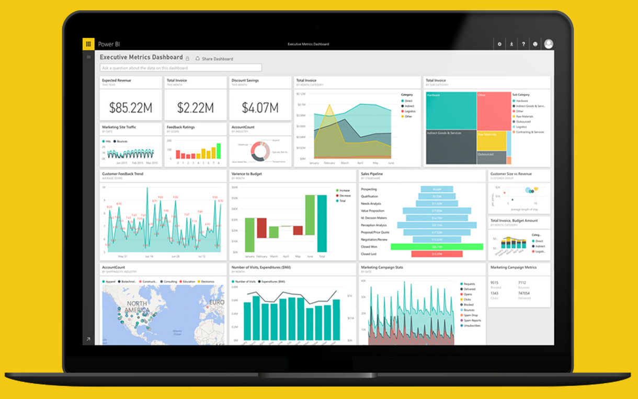
Project Professional Workshop Program
Module 3 – Modeling & DAX

Slide 5
COURSE OBJECTIVES
By the end of this course, you will be able to use DAX to create calculations in a Power BI Desktop data model. Specifically you will be able to:
Understand basic concepts of Data Modeling
Understand the consequences of data model design decisions
Understand concepts of calculated columns and measures
Gain familiarity with standard DAX patterns & CALCULATE
Understand evaluation contexts and their impact on calculations
Gain ability to parse data modeling formulas

Slide 6
COURSE AGENDA
 |  | Introductions and Overview
Module |  | Basic Data Modeling & Power BI Desktop Internals
Module 2 |  | DAX Calculated Columns & Measures
Module 3 |  | CALCULATE
Module 4 |  | DAX Evaluation Contexts
Module 5 |  | Data Modeling: Time Intelligence Functions
 |  | Wrap-up & Questions

Slide 7
COURSE AGENDA
1:00 PM |  | Introductions and Overview
1:10 PM |  | Basic Data Modeling & Power BI Desktop Internals
2:15 PM |  | DAX Calculated Columns & Measures
3:15 PM |  | CALCULATE
3:45 PM |  | DAX Evaluation Contexts
4:15 PM |  | Data Modeling: Time Intelligence Functions
4:15 PM |  | Wrap-up & Questions
Notes:
Instructor – Here is a approx. time flow for the class. Duration 4 hours.
No set slide for Break – break after approx. 2 hours (around end of Module 2)

Slide 8
Advanced Power BI Courses
Shape Your Data into a Data Model with M
Enhance your Data Model
Data Visualization and Story Telling
Excel Analytics Enhanced by Power BI
Dashboard In a Day
Notes:
Advanced – Shape Your Data into a Data Model
Why do you need this course?
Because your data needs to be in the right shape to create an effective data model.
Advanced – Enhance Your Data Model
Why do you need the course?
To take your data model beyond simple aggregations and create more complex calculations that span multiple tables and millions of rows of data.
Advanced – Data Visualization and Storytelling
Why do you need the course?
Because you need to make the right visualization choice to answer the business problem.
Q: Can the classes be scheduled in the progressive order as shown above?
A: Not everyone needs all classes, classes will be available for people to choose as needed.

Slide 9
Module 3
Basic Data Modeling &
Power BI Desktop Internals

Slide 10
MODULE 3 OBJECTIVES
Understand what is meant by data model in the context of Power BI
Understand the consequences of data model design decisions
Understand Power BI’s data storage architecture and use this knowledge to optimize performance
Understand consequences of Power BI’s data type handling

Slide 11
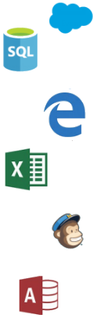

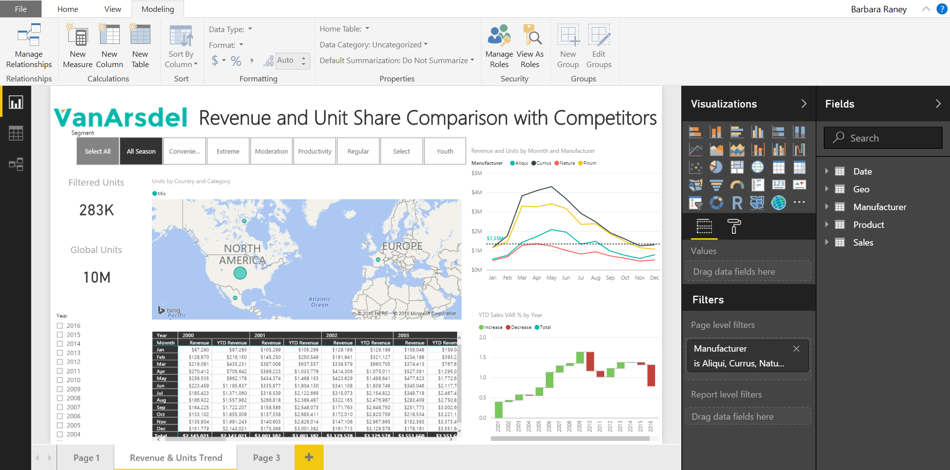
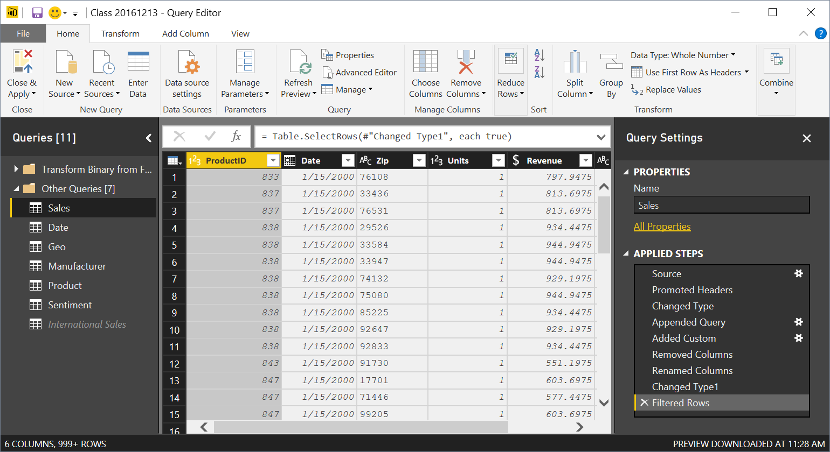

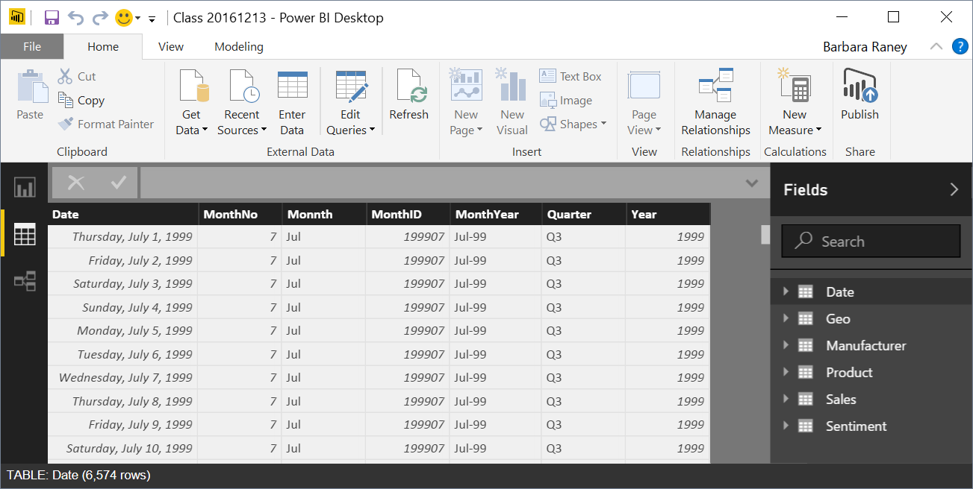
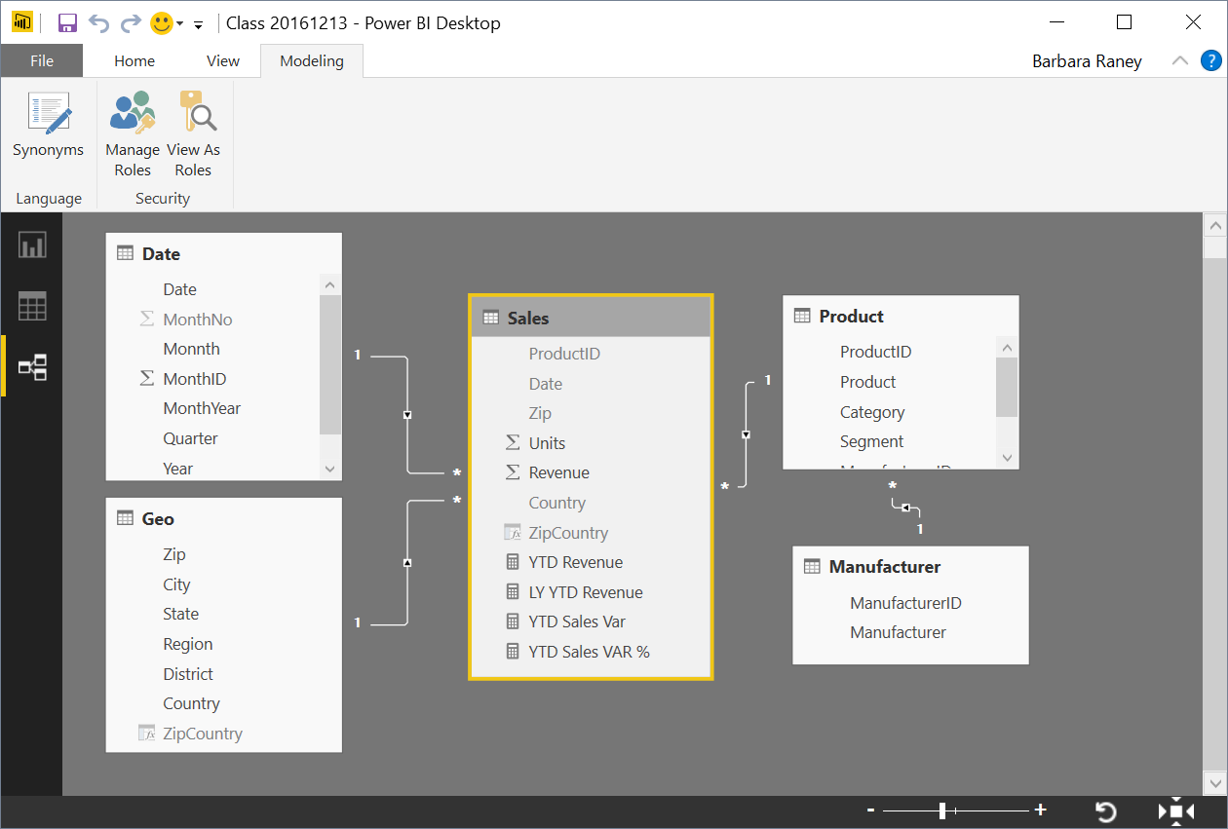
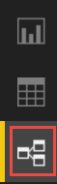

Power BI Desktop Data Flow
Data Sources
Power BI Desktop file (.PBIX)
Report
Create Visuals
Close & Apply
Close: Closes Query Editor
Apply: Loads data from sources to Data Model
Data (DAX)
View Tables
Query Editor (M)
Data Source Connections
Data Transformations
(Prep data for Data Model)
Relationships
See how Tables relate to each other
Notes:
This build slide emphasizes that the Query editor is for transformations and is a different window than the primary modeling views.

Slide 12
What is a Data model?
Basic Data Modeling & Power BI Desktop Internals
A Power BI Data Model is a collection of tables with relationships which enable your business users to easily understand and explore their data to get business insights.
Why is it important to have a Good Data model?
Improves understandability of the data
Increases performance of dependent processes and systems
Increases resilience to change
Notes:
In a good Data Model, the model can assume that column types are homogeneous (as they are strongly typed). This is different from Excel, where any given cell in a spreadsheet can contain different data types.

Slide 13
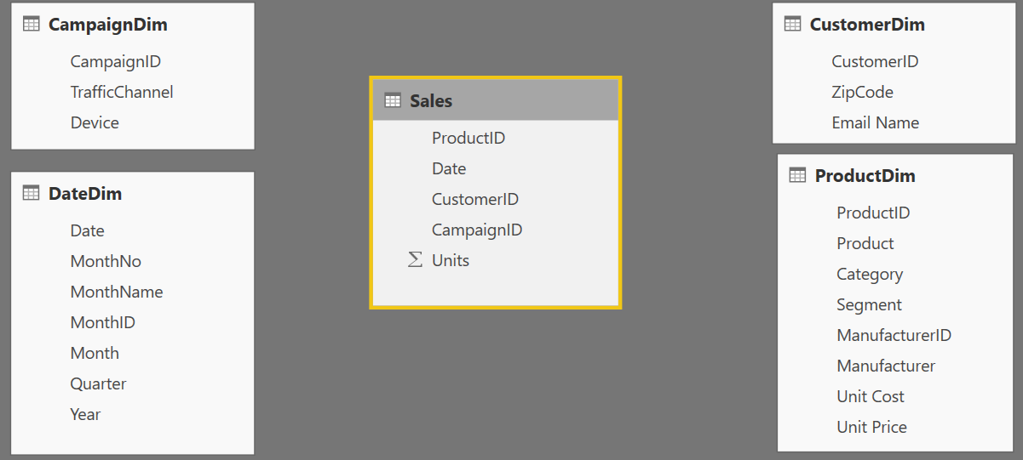
Components of a data model – Fact Table
Basic Data Modeling
Fact
Table
Fact Table
Contains Measures (or items to be aggregated) of a business process Examples:
Transactions
Sales Revenue
Units
Cost
Measures are usually sliceable. Examples:
By Month, By Customer
Notes:
This slide builds automatically.
Depicts the data flow for Power BI Desktop along with what is in a PBIX file.
Note all the data sources that can be pulled into Query Editor.
Not the different views (Report, Data, Relationships) once all of the data is pulled in.

Slide 14
Components of a data model – Dim Table
Basic Data Modeling
Dim
Table
Dim
Tables
Dim
Table
Dim
Tables
Dim Table
A Dim (or Dimension) table contains descriptive attributes that define how a fact should roll up.
Examples:
By month, By Customer, By Geo
Notes:
The BY’s will be the dimensional attributes that we will use to describe the facts.

Slide 15

Components of a data model - Relationships
Basic Data Modeling
Relationships
Connection between a 2 tables (usually fact & Dim tables) using columns from each
3 kinds of Relationships
1 to Many
1 to 1
Many to Many
(with a bridge table)
Relationships
Relationships
Notes:
A Relationship is analogous to how an Excel VLOOKUP function brings two tables together
Can observe which side is the many (*) and which is the one (1) - CARDINALITY
When you draw the relationship, Desktop does several heuristic things
It checks that one side of the relationship is the “One” and the other is the “Many”
Directions of Relationship
Uni-directional are created by default and allows filters to get passed from attribute (dim) table to the Fact
Bi-Directional relationship allow you to pass filters in both directions
This is different than Many to Many
There is a significant performance penalty for Bi-Directional filtering

Slide 16
Data Model Brings Facts and Dimensions Together
Basic Data Modeling
Type of Data Models
Star Schema
Snowflake Schema
Flat or Denormalized
Note: This is not an exhaustive list, but are the most common model types used by Power BI.

Slide 17
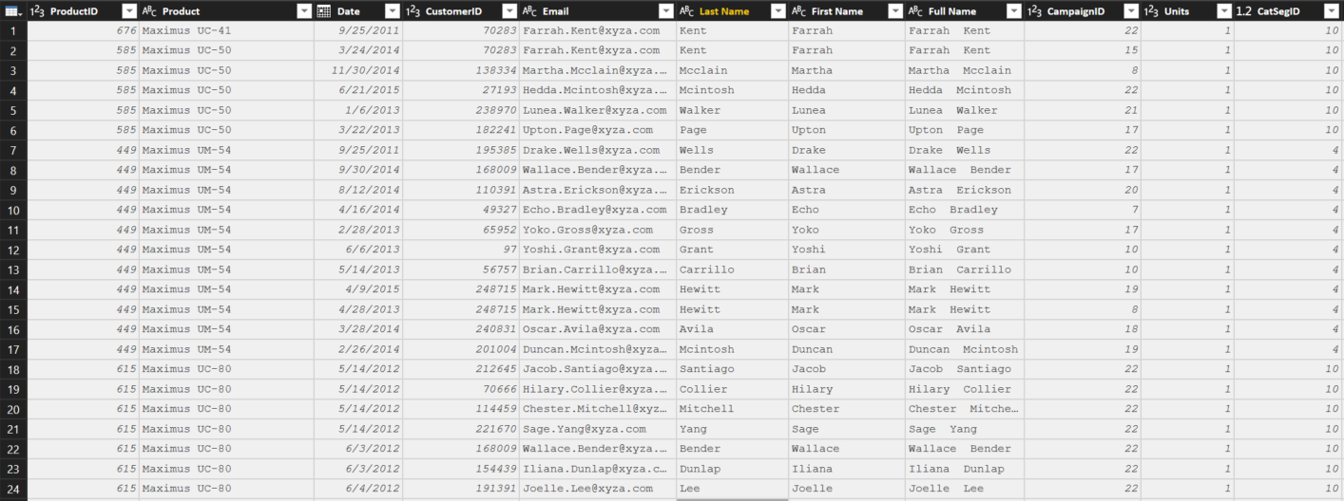
Flat or Denormalized schema
Basic Data Modeling
All attributes for model exist in a single table
Highly inefficient
Model has extra copies of data > slow performance
Size of a flat table can blow up really quickly as data model becomes complex
Notes:
Similar to Excel with many V-Lookups
Denormalized are flattened versions where all attributes are copied into the same table
This is a requirement of a certain “T” competitor – and a major differentiator in the market

Slide 18
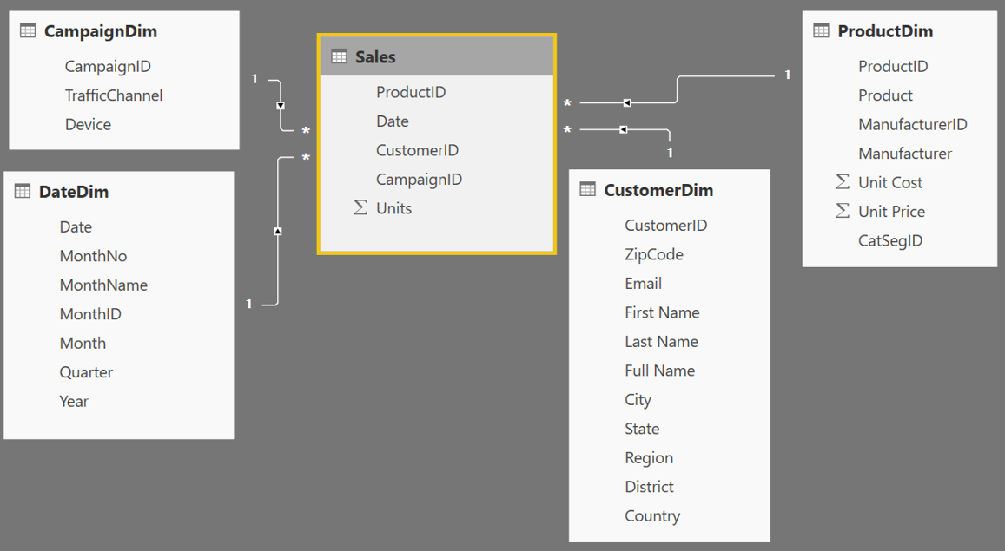
Star Schema
Basic Data Modeling
Fact table in the middle
Surrounded by Dims
Looks like a ‘Star’
Fact table is the “Many” side of the (one to many) relationship
1
1
1
Many
1
1
Many
Notes:
By extracting the repeated attributes to dimension tables, you are lowering the amount of memory required by the data model.

Slide 19
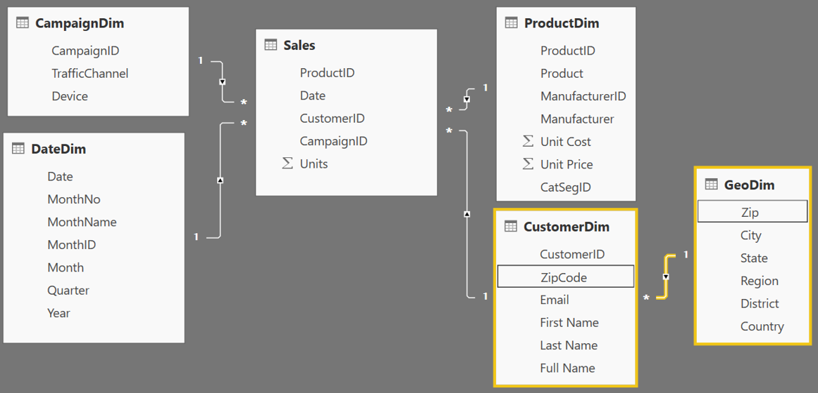
Snowflake Schema
Basic Data Modeling
Center is a Star schema
Fact table in middle
Surrounded by Dims
Dims “snowflake” off of other Dims
If you have many, it looks like a ‘Snowflake’
Dim or Fact tables can be the “Many” side of the relationship
Dims
Facts
Dims
Flake
Snowflake
Notes:
“Snowflaking” off tables can be very beneficial when your dimensions have several repeating attributes that can be extracted to their own table.
A zip code is associated with multiple attributes
Talk about your own zip code and the richness associated with that particular zip

Slide 20
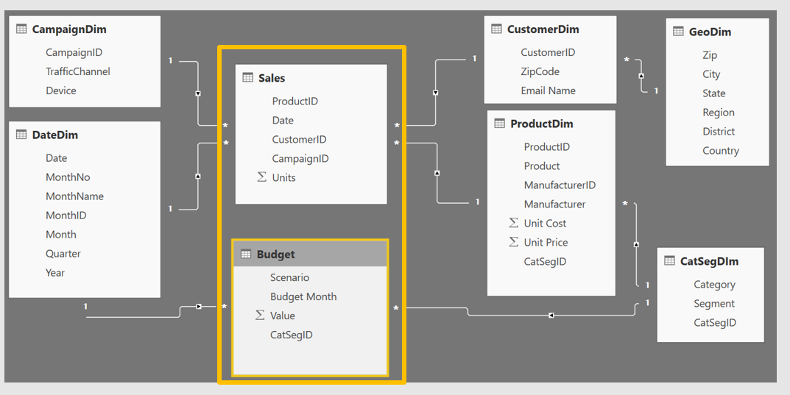
Granularity & Multiple Fact
Basic Data Modeling
Grain (granularity) measures the level of detail in a table
Example:
One row per order or per Item
Daily or Monthly date grain
If your facts have very different granularities, split them into Multiple Fact tables & connect them to shared dimensions at the lowest common granularity.
Sales (Daily by Product)
Budget (Monthly by Product Category & Product Segment)
Notes:
Keep in mind, your measures (calculations) should be placed on a fact table, but it really does not matter which one. The key is that measures should not be placed on dimension tables. If students want more detail on Why, send them to the DAX class for more detailed discussion.
When you have a fact at the Month grain, like budget, you can create a calculated column which holds the first (or last) day of the month to use in creating the relationship.

Slide 21
What is unique about Power BI Desktop
Basic Data Modeling & Power BI Desktop Internals
Columnar database
In-memory database
Let us understand some of the internals of Power BI Desktop !!
Notes:
Why do I care: This will assist you in writing good DAX

Slide 22
Columnar Database
Basic Data Modeling & Power BI Desktop Internals
Row Based Database
PBI - Columnar Database
First Name | Last Name | Sales
John | Smith | $10
Jane | Doe | $25
Hardy | B | $35
First Name | Last Name | Sales
John | Smith | $10
Jane | Doe | $25
Hardy | B | $35
Stores each row separately (like a separate file)
Retrieving multiple columns from a single row is fast
Retrieving multiple rows from a single column is slower
Stores each column separately (like a separate file)
Retrieving multiple columns from a single row slower
Retrieving multiple rows from a single column is faster
Columnar databases are well suited for analytics
Notes:
No Additional Notes.

Slide 23
In-Memory Database
Basic Data Modeling & Power BI Desktop Internals
PBI – In-Memory Database
Data stored in RAM (in memory)
RAM is all electronic – Read/Write is fast
Laptops have smaller RAM space (~8GB)
Power BI compresses data to conserve space in RAM
Notes:
Every Row is stored in a separate “File”
How many files do I open to get the “total Sales”?
For ANALYTICAL - To get the total sales – it will only need to open ONE File
* Column based architecture is better for Analysis

Slide 24
How Power BI Compresses Data – Dictionary Encoding
Basic Data Modeling & Power BI Desktop Internals
Sale Id | Color | Sales Amount
390a30e0-dc37 | Red | $10
390a30e1-dc37 | Green | $25
390a30e2-dc37 | Red | $35
390a30e3-dc37 | Red | $15
390a30e4-dc37 | Red | $25
390a30e5-dc37 | Green | $30
390a30e6-dc37 | Blue | $10
390a30e7-dc37 | Blue | $12
390a30e8-dc37 | Blue | $15
390a57f0-dc37 | Blue | $18
390a57f1-dc37 | Green | $25
Red = 1 Green = 2 Blue = 3
Create a Dictionary to create an integer value for text string
Storing 1,2,3 instead of “Red”, “Green”, “Blue” saves memory
Dictionary encoding is powerful when there are few unique values in a column
Ex. Color column – Good for dictionary encoding
Ex. Sale ID – Bad for dictionary encoding
Notes:
We tend to be data “Hogs” - which columns do you really need?
In a proper Star Schema, Dictionary Encoding would primary affect Dimension table, or text fields on Fact table (of which there should be few, if any).

Slide 25
How Power BI Compresses Data – Run Length Encoding
Basic Data Modeling & Power BI Desktop Internals
Sale Id | Color | Sales Amount
390a30e0-dc37 | Red | $10
390a30e1-dc37 | Green | $25
390a30e2-dc37 | Red | $35
390a30e3-dc37 | Red | $15
390a30e4-dc37 | Red | $25
390a30e5-dc37 | Green | $30
390a30e6-dc37 | Blue | $10
390a30e7-dc37 | Blue | $12
390a30e8-dc37 | Blue | $15
390a57f0-dc37 | Blue | $18
390a57f1-dc37 | Green | $25
Run Length Encoding in Power BI
Instead of storing - 1, 2, 1, 1, 1, 2, 3, 3, 3, 3, 2
It Stores:
Run length encoding is very powerful when data is sorted well and has few unique values
1
2
1
1
1
2
3
3
3
3
2
Where Red = 1 Green = 2 Blue = 3
1 – 1 (1 instance of One)
1 – 2 (1 instance of Two)
3 – 1 (3 instances of One)
1 – 2 (1 instance of Two)
4 – 3 (4 instances of Three)
1 - 2 (1 instance of Two)
Notes:
Image compression technique which is used to compress black and white images. The PowerBI team is using this same Run Length compression.
If you have 10,00 TRUEs then 10,000 FALSEs, it will provide the best compression of the column
Memory compression and performance are directly related
Mention Kaspers’ calculation blog post to find out how your memory is used. (Link in Post)

Slide 26
Practical Example of Compression
Basic Data Modeling & Power BI Desktop Internals
Dashboard in a Day Class Data
DIAD Complete Data Model
Sales Fact | 420.0 MB
Dimensions | 4.4 MB
Int’l Sales | 32.4 MB
Total Data | 456.8 MB
Data Model | 59.4 MB
Almost 8X Compression!!
Queries ONLY – No Data Loaded
Query Metadata | 113 KB
Notes:
* When the file is closed – it is saved to the hard disc
When opened, the DB is stored in RAM (Approx 60% of machine’s available RAM)
Hard Disk has mechanical parts - read/writes are slower
In-Memory – read/writes are faster
RAM is precious, and the PowerBI team uses many techniques to compress data
In the Service, datasets are limited to 1 GB.

Slide 27
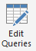

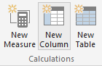
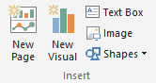
Phases in Building a Power BI Desktop File
Basic Data Modeling & Power BI Desktop Internals
“Get Data” Phase
Model Creation Phase
Model
Enhancement
Phase
Visual
Building Phase
Create Query in “M”
Compress data, auto detect relationships
(Automatically done by Tool)
Add calculated columns, measures, add missing relationships
Evaluate Measures and build each visual
Notes:
Should be 1 hour into the training at this point
In Power BI desktop connect to Raw Data Excel file that contains all data for the Power BI model. Pull Sales Fact , Geo and Date
Show the Get data phase
Show how if you do apply later and save just the “Query information” is saved
If you apply data – Data transformation changes are saved (All data is loaded, and most relationships are created)
Add a relationship for the date column
Show how you can add a calculated column and measure
Calc Column on Product Dimension: Price Band = IF(ProductDim[UnitPrice]> 10, “High”, “Low”) – memory inefficient – less optionally compressed as is not sorted
Measures: Total Sales = Sum(SalesFact[Sales]) – no result yet – as a measure is ONLY calculated when a visual is built
Finally build a few visuals and show how the measures are evaluated during visual building phase – you can start with a simple matrix to check values
Process Time Vs. Query Time
Time to take to process the model (Process) includes all calc columns
Time to build a Visual (Query) includes measures

Slide 28
Key takeaways to design a good Power BI Desktop data model
Basic Data Modeling & Power BI Desktop Internals
RAM is precious !!!!!
Some Tips and tricks to save RAM and increase speed of model
If a fact table contains an ID field which is unique for each record, remove it
Ex. Transaction ID
Sort columns before bringing them into a Power BI data model
The DateTime data type is usually not needed, unless you are specifically using the Time component
If you really need Time, try splitting Date & Time into two columns - Reduces # of unique values
Star Schema – Good for most Data Models
Notes:
* When the file is closed – it is saved to the hard disc
When opened, the DB is stored in RAM (Approx 60% of machine’s available RAM)
Hard Disk has mechanical parts - read/writes are slower
In-Memory – read/writes are faster
RAM is precious, and the PowerBI team uses many techniques to compress data
In the Service, datasets are limited to 1 GB.

Slide 29
Data Types
Basic Data Modeling & Power BI Desktop Internals
Set your Data Types in the Query Editor
Set your Data Formats ($ %, etc) in the Data Model
Numeric Data Types
Whole Number
Decimal Number
Fixed Decimal Number (Floating point stored as integer)
Boolean
Date/Time Data Types
Date – Internally stored as an integer
Time – Internally stored as a fraction between 0 and 1
Date Time
Other Data Types
Text
Any – You should never see this in a data model. Bad things can happen!!
Pro Tip: Data type is different from data format
Notes:
Data Types are how data is stored, as opposed to Data Formats which are how data are displayed
Discuss the difference between Fixed Decimal (Currency) and Decimal (which has floating decimal)
Fixed Decimal is 19.4 – 19 places to left of decimal and 4 to the right, which allows for proper processing of pennies. Best for Currency numbers.
Decimal can be less efficient when the data has excessive precision
Discuss splitting DateTime into Date and Time columns so that they compress better
Fixed Decimal numbers – stored like whole number uses less memory than Decimal

Slide 30
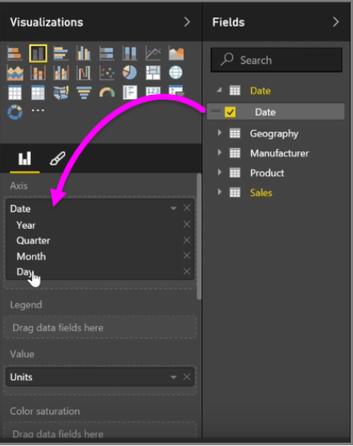
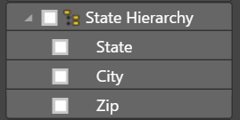
Hierarchies
Basic Data Modeling & Power BI Desktop Internals
Power BI generates Date hierarchies when dates are added to visuals, this allows the end user to drill from Year, Quarter, Month & Day.
Users can also create custom hierarchies in the model by dragging a lower level field onto the parent.
Notes:
Can approximate hierarchies in the drill path of a visual

Slide 31
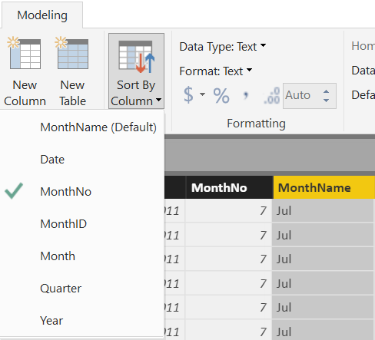
Sort By Column
Basic Data Modeling & Power BI Desktop Internals
Enables sorting one text field by another (numeric) field
Both columns must have the same number of distinct values
Notes:
Sort by Column was shown in DIAD, but it is important modeling concept to know.
This is applied in the Data section of the model.

Slide 32
Module 3 Lab
Creating Relationships
Notes:
The final relationship diagram can be viewed in the Instructor Complete Modeling.pbix file.

Slide 33
Module 3 Lab – Quick Prep
Open up the file Student Modeling Pre-class.pbix
Open the Query Editor
Change the FullPath parameter to the location of VanArsdel_Actuals file
Notes:
The final relationship diagram can be viewed in the Instructor Complete Modeling.pbix file.

Slide 34
Module 3 Lab – Relationships
Create the relationships between the tables!
HINT: You may need to preview some of the tables to see what is in them
Think about: What sort of data model are you creating?
Star Schema

Slide 35
KNOWLEDGE CHECK Module 3
What is a data model in the context of Power BI?
What are some advantages of a star schema over a flat or denormalized model?
How might you improve the performance of a Power BI model?
How does Power BI store DateTime information? What are some consequences of this?

Slide 36
Module 4
DAX Calculated Columns & Measures

Slide 37
MODULE 4 OBJECTIVE
Understand differences between calculated columns and measures (uses, evaluation, performance, etc.)
What is DAX

Slide 38
DAX Level Set
DAX looks similar to Excel functions but they have key differences
DAX is a very deep and elegant…
This class provides a solid base in DAX, but don’t expect to leave being able to write the most complex DAX patterns--they take practice.
Notes:
Let’s be real.
- DAX is easy to get started with (due to similarity to Excel)
- DAX mastery takes a lot of time to acquire
- Subtle differences in DAX formulas can have profound results!

Slide 39
Module 4 - DAX Foundations
What is DAX?
Functional language used in Power BI & Power Pivot to create intelligent values from a Data Model
Compute values over columns in tables
Works with data types to compute aggregations, time intelligence, statistical functions, and logical results
Can be used in Columns & Measures
Notes:
DAX is the basis and foundation of creating intelligent reports in Power BI.
Kinda similar to Excel, but does with a very different approach
Data Analysis Expression language
Computes over an entire data model (tables & columns)
Easy for basics, but to become an expert there is a learning curve in the way of thinking….

Slide 40
Path to DAX Expertise
Module 4 - DAX Foundations
Evaluation Contexts
CALCULATE
Calculated Columns and Measures
Notes:
Even though this class is 200 this is really a 100 level DAX class
DAX answers are not “one size fits all” – we are trying to help you find some hidden gems

Slide 41
Module 4 - DAX Foundations
Calculated Column
Measure
Notes:
Calculated Columns

Slide 42
Module 4 - Calculated Columns in DAX
What is a Calculated Column
DAX expression that applies to every row in a data set
Uses Row by Row Calculation in the current context
Computed during data refreshes
Bound to current row & table
Used for:
Categorize text or numbers
Define an expression for a filter or value
Can also be done in Power Query
Help create relationships
Notes:
Columns
Unlike excel, when you create a column in DAX you can not reference an indivual cell location.
Everything in DAX applies to a entire model / table.
Row by Row Calculation
You should not use this for aggregate functions
Use for
Columns should be used to create categories, values, or other logical references
But you can do a lot of this also in Power Query
Try to do it in Power Query!

Slide 43
Module 4 - Calculated Measures
What is a Measure?
Creates Aggregate calculations
Formula that is evaluated in it’s filter context being used in
Evaluated with every interaction in Report
Implicit & Explicit
Used For
Ratios & Aggregations
Filtering & Segmenting a certain set of data
Complex calculations and logic
Notes:
Measures
They are not in a single row or really a table
They are computed every time their environment changes
Based on the filter context (table, filters applied) and not just the current row
Use it for your time intelligence, aggregations, etc.
Two different types!
Every time you just add a column to a visual, Power BI creates an “Implicit” measure
Explicit is when you define and create a DAX expression
Always try to create Explicit Measures!
Implicit is the default aggregation – explicit is what you create

Slide 44
Module 4 - Measures vs. Columns
It’s all about how DAX computes
Not like Excel… Does not work on cell & locations
Only tables & columns
Basic rule of thumb:
Measures
Aggregations
Date Time
Columns
Referencing a singular value from a row
Categories

Slide 45
Module 4 - Formatting DAX – Standards
Column references are written in the form of TableName[CoumnName], with no space between table & column name
Measure references should never use table name [MeasureName]
Split any expression into rows using Shift+Enter
Notes:
Basic Formatting rules
You really don’t want to create something so confusing it cannot be read!
Also, it is better for the model!

Slide 46
Module 4 - DAX Evaluation Contexts
Any DAX expression is evaluated inside a certain context
The context is the environment under which the formula is evaluated
“The surrounding area of the cell where DAX evaluated the formula”
2 Kinds
Row Context – the context that always contain a single row and DAX defines during the creation of the formula
Filter Context – based on the context defined by it’s current filters & environment
Notes:
Context
Oh boy…. This is the tough one
This does take some time to understand, but basically every DAX expression is evaluated inside a certain “environment”
This depends if it is a column or a measure, in a table or on it’s own
Row Context
More for Calculated Columns – iterates on every row of a table/column
Cannot look at other rows! Just the one it is on
Filter Context
Based on the current area or situation a expression is in
Can ignore row context, especially aggregations.
Not based on every row
For example, a measure of total sales when adding different columns and rows

Slide 47
Demo – Calculated Column

Slide 48
DEMO – Column vs. Filter
What number do you expect to see if you create this calculated column in Sales
Sales[SumOfSalesAmount] = SUM ( Sales[SalesAmount] )
The value of SalesAmount for that row
The total of SalesAmount for all the rows
An error
Notes:
Let’s do an example
We are going to create a Calculated Column that aggregates the total sales amount column. Remember a cc computes row by row.
The row context for the first row, then it invokes the formula evaluation to go through the entire table.

Slide 49
DEMO - Context
Why?
Certain are based on the filter context only, (the table)
What is the current filter context?
DAX evaluates the formula outside of any pivot table in a Column
SUM is an Aggregate function that ignores row context
Notes:
Why did it show up like this – grand total of every row?
SUM ignores row context, and uses the filter context.
And when you do it in a column, there is no (filter). So it is the full table.

Slide 50
Module 4 Lab Creating Calculated Columns and Measures

Slide 51
Module 4 Lab – Creating Calculated Columns & Measures
We need to Create a Category to label price of Products
Use our Relationships, going to create “Price Band”
Price Band = IF ( ProductDim[Unit Price] <= 25, "Low", IF ( ProductDim[Unit Price] <= 50, "Medium", "High" ) )
We can also do this in the Query Editor
if [Unit Price] <= 25 then "Low" else if [Unit Price] <=50 then "Medium" else "High“

Slide 52
Module 4 Lab – Creating Calculated Columns & Measures
Create some basic Columns to get Cost of Goods Sold|
Sales[COGS] = RELATED( ProductDim[Unit Cost] ) * Sales[Units]
Create City State column in Sales
Sales [City State]= RELATED( GeographyDim[City] ) & “, ” & RELATED( GeographyDim[State] )
Notice how we did not have to do a SUM… Going row by row
Notes:
Notice how we do not need to do SUM

Slide 53
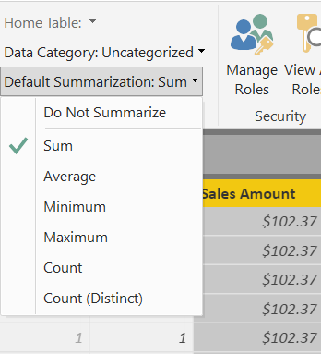
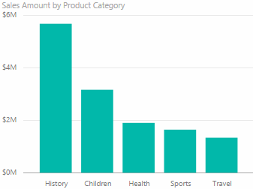
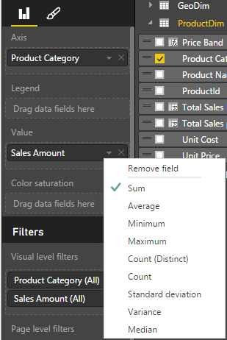
What is a Default Summarization?
Module 4 Lab
On the Modeling ribbon
For an individual visualization
Sales Amount is automatically summed for each category
You should set this summarization for all numeric fields in the Modeling ribbon
Notes:
For fields like Year, which are numeric, but you would prefer to not summarize, set the global Default Summarization on the Modeling Ribbon
DEMO: Show Default Summarization tab
Instructor Note:
Ask the participants why it works (ie. How does it know to Sum?).
When you drop a calculated column into the visual, Power BI creates Implicit Measure (using Default Summarization). In this case, the implicit measure is Sum of Calc COGS.
Bring in Sales Amount column from the Sales Fact Table into the value section of the graph on the top left hand side.
Instructor Note:
Creates Implicit Measure – Default Summarizations – we can change it.
Dropping a Text column into the Values – will create a count.
Revert this to a Sum on the sales amount at the end of the demo. We will be using the Sales Amount again and we want to make sure it is a Sum.

Slide 54
Module 4 Lab – Creating Calculated Columns & Measures
Create Total Sales Measure
Total Sales := SUM( Sales[Sales Amount] )
Create COGs Column & Measure
Sales[COGS] = RELATED( ProductDim[Unit Cost] ) * Sales[Units]
[Total COGS] := SUM ( Sales[COGS] )
Create Profit Measures
[Profit] := [Total Sales] - [Total COGS]
[Profit Margin %] := Divide( Profit , COGS )

Slide 55
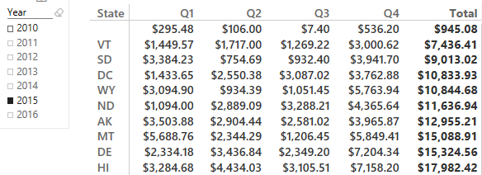
Calculated Column vs. Measure - When to Use What
Module 4 - DAX Foundations
Columns
Values
Slicer
Rows
Rule of Thumb for Calculated Column vs Measure
Calculated Column – Use in Page, Report & Visual Filters as well as Slicers, Rows and Columns
Measures - Use in Values section
Notes:
Values use either an implicit Measure or Explicit Measure (explicitly written DAX)

Slide 56
Module 5
CALCULATE

Slide 57
MODULE 5 OBJECTIVE
Understand the basics of the CALCULATE formula

Slide 58
PATH to DAX Expertise
DAX Foundations
Evaluation Contexts
CALCULATE
Calculated Columns and Measures
Notes:
Evaluation Context – Single biggest reason that people give up on DAX
Want to Simplify the Evaluation Context

Slide 59
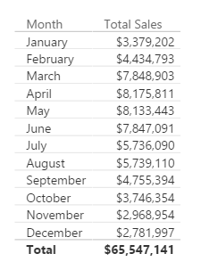
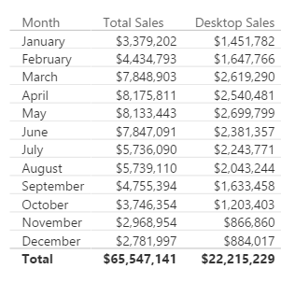
Why is CALCULATE Useful?
DAX Foundations
You create a report of breakdown of Sales by Month
Typical Business Question:
Provide a break out of this Sales from Desktop
Notes:
In Excel, there are SUMIF and SUMIFS functions – Calculate give you that flexibility and much more as it can be used with ANY Aggregation/Calculation
MYR – Drill to one Department’s data – and change the shape and it will all still work

Slide 60
Here is how you do it with CALCULATE
DAX Foundations
[Desktop Sales] = CALCULATE([Total Sales], CampaignDim[Device] = "Desktop")
Use CALCULATE function to create a Measure which filters down to Desktop Sales
Notes:
Note that even if you apply a “Device” Slicer to this page, the measure [Desktop Sales] will always show Desktop

Slide 61
Anatomy of CALCULATE
DAX Foundations
CALCULATE(Expression, [Filter 1], [Filter 2]…..)
Filter Arguments
EXPRESSION used as the first parameter is essentially the same as a measure
CALCULATE works differently from other DAX functions
The second set of arguments, i.e. the “Filter arguments,” are evaluated and applied first
Then the Expression is evaluated under new “Filter Context"
Notes:
ALL Filters arguments are ANDs – FILTERS ARE CALCULATED FIRST (to filter the rows), then the math is applied

Slide 62
CALCULATE – Steps in Evaluating the CALCULATE Function
DAX Foundations
CALCULATE(Expression, [Filter1], [Filter2]…..)
Step1 : Copy the current filter context
Step 2: Add new filters if any
Step 3: Update/ignore existing filters if any
Step 4: Convert row context to filter context
Step 5: AND all filter conditions to create new filter context
Step 6: Evaluate the Expression
Step 7: Return back to original filter context
Notes:
ALL Filters arguments are ANDs – FILTERS ARE CALCULATED FIRST (to filter the rows), then the math is applied
Within one Filter argument, you can use the double pipe “||” to “or” conditions together. See the Example in YTD Revenue.

Slide 63
CALCULATE – The Most Important Function in DAX
DAX Foundations
4 Key functions that CALCULATE can do:
Add Filter
Ignore Filter
Update Filter
Convert Row Context to Filter Context
Notes:
Transition slide

Slide 64
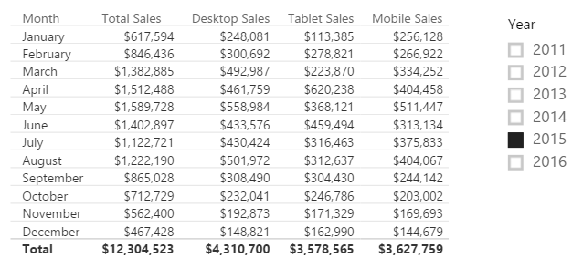
CALCULATE – Add Filter
DAX Foundations
[Desktop Sales] = CALCULATE([Total Sales], CampaignDim[Device] = "Desktop")
[Tablet Sales] = CALCULATE([Total Sales], CampaignDim[Device] = “Tablet")
[Mobile Sales] = CALCULATE([Total Sales], CampaignDim[Device] = “Mobile")
Notes:
Demo: Table from “Calculate-Add” report
Note the effect that the Year Slicer has on the table (All items change)
When the Device Slicer is selected, only “Total Sales” changes.
Filter Context : Jan + 2015
Jan + 2015 + Desktop
Jan + 2015 + Tablet

Slide 65
CALCULATE – The Most Important Function in DAX
DAX Foundations
4 Key functions that CALCULATE can do
Add Filter
Ignore Filter
Update Filter
Convert Row Context to Filter Context

Slide 66
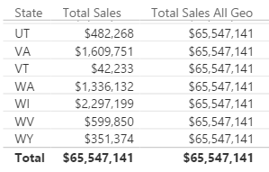
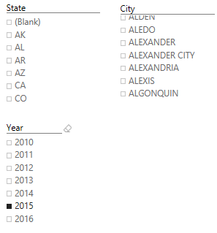
CALCULATE – Ignore an Existing Filter
DAX Foundations
[Total Sales All Geo] = CALCULATE([Total Sales], ALL(GeographyDim))
Notes:
DEMO “Calculate- Ignore” Tab:
The table visualization, with each slide, expose the related column
Expose measure called [Total Sales All Geo] – Ignore filter on ANY column from the GeographyDim table, but allows filters from Year
Discuss that this measure can be used to calculate a % of Total measure

Slide 67
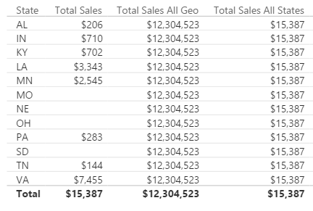
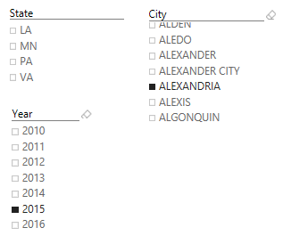
CALCULATE – Ignore an Existing Filter
DAX Foundations
[Total Sales All States] = CALCULATE([Total Sales], ALL(GeographyDim[State]))
Notes:
DEMO “Calculate- Ignore” Tab:
The table visualization, with each slide, expose the related column
Expose measure called [Total Sales All State] – Ignore filter on the STATE column from the GeographyDim table, but allows filters from Year
Slice on City (Aberdeen is good)

Slide 68
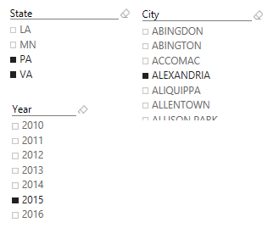
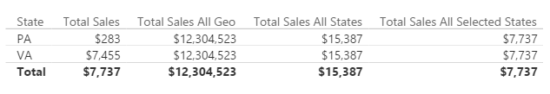
CALCULATE – Ignore Existing Filter
DAX Foundations
[Total Sales All Selected States] = CALCULATE([Total Sales], ALLSELECTED(GeographyDim[State]))
Notes:
DEMO “Calculate- Ignore” Tab:
The table visualization, with each slide, expose the related column
Expose measure called [Total Sales All Selected State] – Ignore filter on the STATE column from the GeographyDim table, but allows filters from Year
Slice on City (Aberdeen is good), then select multiple State, see that the measure now only displays the total for selected states.

Slide 69
CALCULATE – The Most Important Function in DAX
DAX Foundations
4 Key functions that CALCULATE can do
Add Filter
Ignore Filter
Update Filter
Convert Row Context to Filter Context

Slide 70
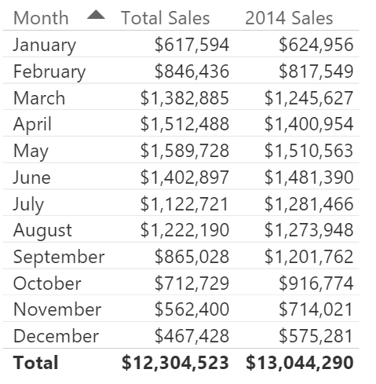
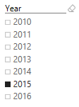
CALCULATE – Update Existing Filter
DAX Foundations
[2014 Sales] = CALCULATE([Total Sales], DateDim[Year] = 2014)
Notes:
DEMO “Calculate- Update” Tab:
The measure called [2014 Sales] – Ignores filter on the Year Slicer.

Slide 71
CALCULATE – The Most Important Function in DAX
DAX Foundations
4 Key functions that CALCULATE can do
Add Filter
Ignore Filter
Update Filter
Convert Row Context to Filter Context
Let’s investigate what we mean by Filter Context
Notes:
Transition to Evaluation Contexts: Row & Filter

Slide 72
Module 4 DAX Evaluation Contexts

Slide 73
MODULE 4 OBJECTIVES
Understand that there are different kinds of evaluation contexts and be able to explain what different contexts are in play
Be able to use iterator functions and CALCULATE to create sophisticated measures

Slide 74
PATH to DAX Expertise
DAX Foundations
Evaluation Contexts
CALCULATE
Calculated Columns and Measures

Slide 75
Evaluation Context
DAX Foundations
There are two contexts under which calculations are evaluated
Row Context
Filter Context
Notes:
Two gods you can invoke in your DAX calculation
Can be blended in a single calculations

Slide 76
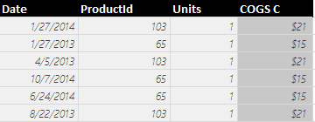
Row context in Calculated Column
DAX Foundations
Sales[COGS] = RELATED(ProductDim[Unit Cost]) * Sales[Units]
Formula is evaluated row by row
The context under which formula is evaluated for each row is called “Row Context”
Pro Tip: To accumulate up from Fact to Dimension, use RELATEDTABLE()
Notes:
Row context invoked when you refer to a column in a calculated column formula without an aggregation function surrounding it
Row Context – How many units sold in Row 1?

Slide 77
Evaluation Context
DAX Foundations
Both Calculated Columns and Measures are always evaluated under two contexts
Row Context
Filter Context
Notes:
Filter Context is defined by the Visual

Slide 78
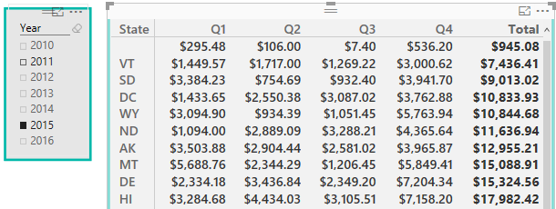
Filter Context in Measures
DAX Foundations
[Total Sales] = SUM(Sales[Sales Amount])
Filter Context for current coordinate
Year = 2015,
State = HI,
Quarter = Q1
Formula is evaluated for each “Coordinate” in each visual
The context for each coordinate is called “Filter Context”
Notes:
Discuss the filter context for the selected cell

Slide 79
Filter Context in a Measure – Example 2
DAX Foundations
[Total Sales] = SUM(Sales[Sales Amount])
Filter Context for current coordinate
Year = 2015,
State = ND,
Quarter = Q3
Notes:
One filter context for each COORDINATE in each Visual
Which subset of data are you using to calculate the number

Slide 80
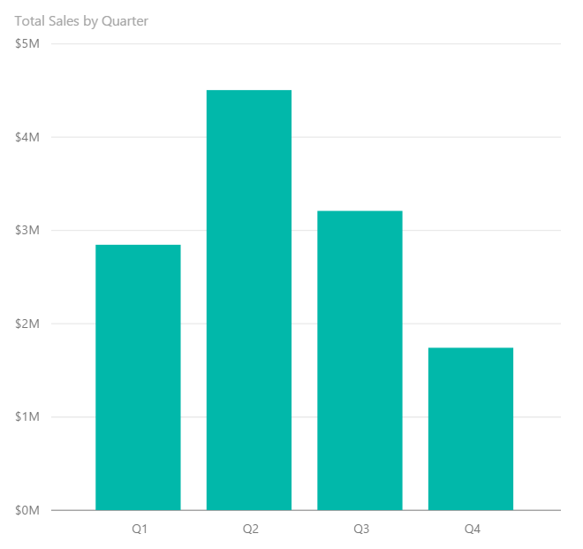
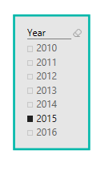
Filter Context in a Measure – Example 3
DAX Foundations
[Total Sales] = SUM(Sales[Sales Amount])
Filter Context : Year = 2015, Quarter = Q1
Filter Context : Year = 2015, Quarter = Q2
Notes:
Charts and Graphs also have Filter Context. EACH data point has a unique Filter Context

Slide 81
Filter Context in a Measure
DAX Foundations
[Total Sales] = SUM(Sales[Sales Amount])
Better definition of above measure:
“Total Sales” – SUM of Sales[Sales Amount] column under a filter context
Notes:
A measure is not evaluated until it is in a Visual – and will be under a filter context

Slide 82
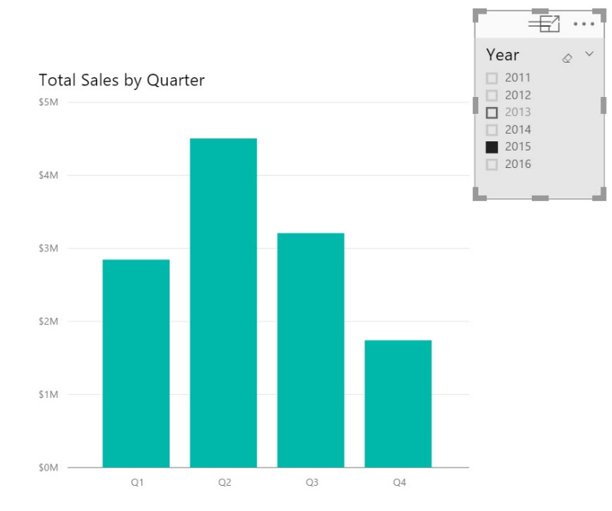
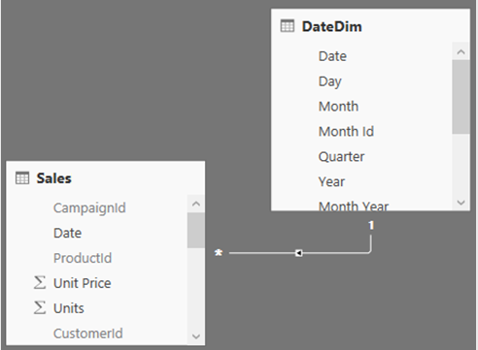
Filter Context and Multiple Tables
DAX Foundations
Filter context automatically propagates from Dim Table to Fact Table
Filtering the DateDim Table to Year = 2015 returns only Sales for 2015
Notes:
In a Uni-Directional relationship, the filter can only flow from the Dim to the Fact
In a BI-Directional relationship, the filter can flow each way.

Slide 83
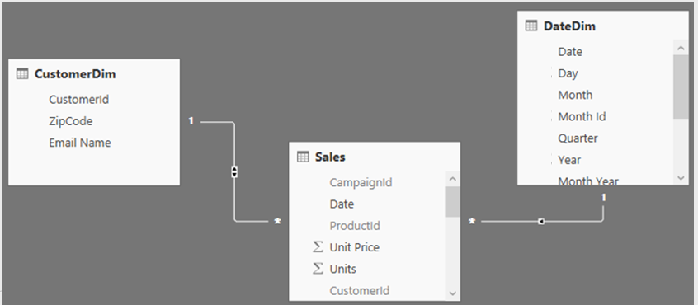
Filter Context and Multiple Tables
DAX Foundations
Filters (Filter context) automatically propagate based on direction of arrows in relationships
Examples
Filter goes from DateDim to CustomerDim
Filter does not go from CustomerDim to DateDim
Notes:
In a Uni-Directional relationship, the filter can only flow from the Dim to the Fact
In a BI-Directional relationship, the filter can flow each way.

Slide 84
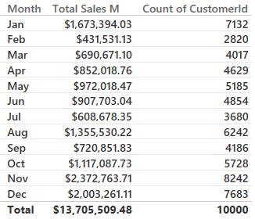
Filter Context and Multiple Tables – Right Arrow Direction
DAX Foundations
Cross filtering works properly
Arrow allows filters
Arrow allows filters
Filter goes from DateDim to CustomerDim
This is why the above Pivot table works
Notes:
DEMO: Show going to the data model and updating the relationship from Single to Both (or back)
Why can’t I just enable all bi-directional relationships
They are expensive
Only turn them from Uni- to Bi- when absolutely necessary

Slide 85
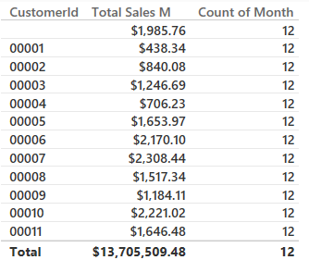
Filter Context and Multiple Tables – Wrong Arrow Direction
DAX Foundations
Cross filtering does not work
Arrow allows filters
Arrow does not allow filters to flow to DateDim
Filter goes from DateDim to CustomerDim
This is why the Count of Month in the table above is incorrect
Notes:
DEMO – Filter Context Multiple Table tab

Slide 86
Evaluation Context Multiple Table – Summary and Take Aways
DAX Foundations
Row Context
Filter Context
Does not propagate automatically
Need to use
RELATED
RELATEDTABLE
Propagates automatically
Depends on direction of arrow in relationship diagram

Slide 87
DAX Function Types
DAX Foundations
Scalar Functions
Table Functions
Scalar functions return a Single value as an output
Ex. SUM(Sale[Sales Amount])
Table functions return a Table as an output
Ex. ALL(GeographyDim)
There are other ways to classify functions – By kind of operation they perform etc.
Notes:
Scalar is a fancy word for using a single coordinate in the evaluation
What if you want bring in a Table or List of values and apply your calculation to them?

Slide 88
Applications of Table functions
DAX Foundations
Table functions can be used 2 ways in Power BI Desktop
As an input to another DAX function
CALCULATE
Iterator functions
Calculated Tables
Notes:
Demo CALCULATED Table example in Power BI Desktop model
Call out the fact that CALCULATED Tables are just like a calculated column – Calculated during processing time or refresh time
You can use this table just like any other DAX in the model – You can create relationships etc.
Go to the Desktop and create a new Demo Table = ALL(GeographyDim) – duplicate with a separate memory footprint.

Slide 89
Basic TABLE functions
DAX Foundations
Return All Rows
Return Distinct Rows
Return Filtered Rows
ALL & variants
ALL, DISTINCT, VALUES
FILTER
There are more advanced Table functions, which we will not cover
Notes:
We will discuss three classes of Table function
No demo yet.

Slide 90
Basic Table functions – Return All Rows
DAX Foundations
The ALL function - Can take either Table or Columns in a Table as input
ALL with Entire Table
ALL with One Column
ALL with Multiple Columns
ALL(GeographyDim)
ALL(GeographyDim[Region]))
ALL(GeographyDim[Region],
GeographyDim[State])
Returns all rows all columns in Table
Returns all unique values of Column
Returns all unique combinations of Column values
Notes:
Demo:
Create a Demo Calculated Table. Discuss Calculated Tables and how are they created.
DemoTable = All(GeographyDim).
Calculated Tables can be used like any other table
You can Build relationships
You can use this to test other complex Table functions
These are like Calculated Columns – Computed during process time
Show ALL and its variants – Start with ALL and work your way through (use slide as a guide)

Slide 91
Basic Table functions – ALL versions
DAX Foundations
There are several forms of the ALL function
ALL
ALLEXCEPT - Return all columns in a Table except 1 or more columns
ALLSELECTED – Return all values in a column selected by users in Slicers
ALLNONBLANKROW – Return all non-Blank rows
Notes:
We demonstrated these functions in the CALCULATE section
Table1 – has a duplicate row
When I write ALL on the whole table, I get the whole table
When I write ALL on the two columns of the table, it removes duplicates
Blank vs a mismatch
ALLEXCEPT - Overrides all context filters in the table except over the specified columns; useful when you want only one column on a table to be sliceable
ALLSELECTED – just like ALL, but if the column is specifically selected, then it respects the slicer
ALLNONBLANKROW – Just like ALL, but does not return any blank rows

Slide 92
Basic Table Functions – Return Distinct Rows
DAX Foundations
VALUES – Return all distinct values in a column or Table
(including blank rows)
DISTINCT - Return all distinct values in a column or Table
(not including blank rows)
Notes:
If when you write VALUES and get a blank you may have Blank or MisMatch
If you change a VALUES to DISTINCT and you still have blank – then it is a real blank – NOT A MISMATCH
Blank vs a mismatch – If your model has Fact rows which do not match with dimensions, this is a mismatch – not a true blank.

Slide 93
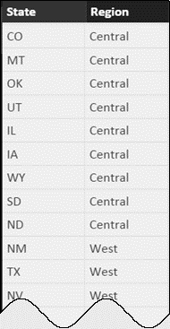
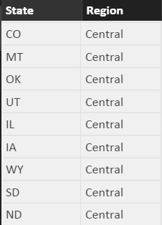
Basic Table Functions – Return Filtered Set of Rows
DAX Foundations
FILTER(ALL(GeographyDim[Region], GeographyDim[State]), GeographyDim[Region] = “Central”)
Take all unique combinations of GeographyDim[Region], GeographyDim[State]
Filter down to the rows where GeographyDim[Region] = “Central”
Notes:
The Region = “Central” is in a ROW Context as it is not surrounded by aggregate function

Slide 94
DAX Iterator Functions Take Advantage of Evaluation Context
DAX Foundations
Iterator Functions
Creates a row context by iterating over a table that you specify
Ex. SUMX
Notes:
The table could be calculated ALL(DimGeography[State]) or a table in the data model DimGeography

Slide 95
Table Functions Application – Iterators
DAX Foundations
[COGS] = SUMX(Sales, Sales[Units] * RELATED(ProductDim[Unit Cost]))
Argument 1
Argument 2
Notes:
An iterator function takes two arguments – we will walk through this example over the next couple of slides

Slide 96
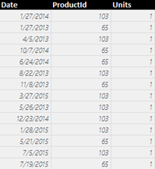
Table Functions Application – Iterators
DAX Foundations
[COGS] = SUMX(Sales, Sales[Units] * RELATED(ProductDim[Unit Cost]))
Argument 1
Iterate through each row in Argument 1
Sales
Notes:
Like a virtual calculated column, but don’t need to perpetually keep the column.
Argument 1 – iterate thru each of the columns in the table argument

Slide 97
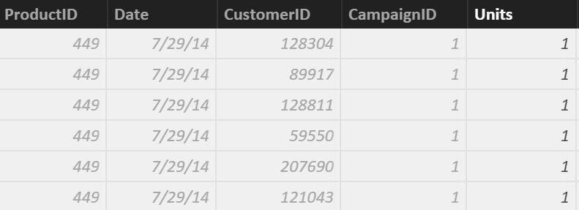
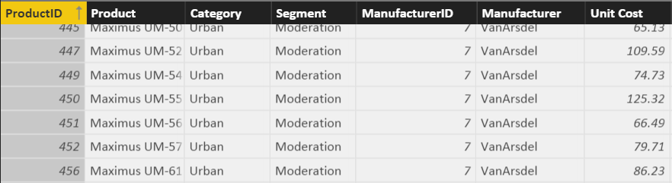
Table Functions Application – Iterators
DAX Foundations
[COGS] = SUMX(Sales, Sales[Units] * RELATED(ProductDim[Unit Cost]))
Argument 2
Sales
ProductDim
Notes:
Perform the calculation for each row in the table argument

Slide 98
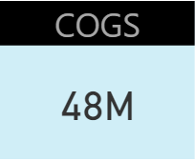
Row Context in a Measure – Iterator Functions
DAX Foundations
[COGS] = SUMX(Sales, Sales[Units] * RELATED(ProductDim[Unit Cost]))
SUM it up
SUM up list obtained
Notes:
Sum the results of all the rows.
Note: This calculation respects the Filter Context of the visual
This example is effectively SumProduct in Excel

Slide 99
Why Can an Iterator be a Better Approach then a Calculated Column?
DAX Foundations
You avoid creating a Calculated Column
Let us see the impact of a Calculated Column Called COGS on Data model with 100K rows - What if we have 10 M rows?
Iterators help you avoid several “Intermediate Calculated Columns”
Notes:
DEMO: In your working copy of “Student Modeling Pre-class.pbix” where you have the calculated column [COGS] –
* Save the file and note the size for the class
* Remove the [COGS] calculated Column and re-save the file.
* Note that the file size is about 8% smaller. While file size is not an exact measure of memory use, it is a proxy that most students understand.

Slide 100
Iterator Function Example 2 – Dynamic Segmentation
DAX Foundations
Sales Velocity Segment = IF(
SUMX(RELATEDTABLE(Sales), Sales[Sales Amount])>=200000,
“High Velocity”,
“Low Velocity”
)
Notes:
FYI: This is a calculated column!
DEMO: Show this calculation in the Product Table (Data View)

Slide 101
CALCULATE – Converting Row Context to Filter Context (Example 1)
DAX Foundations
Sales velocity Segment = IF(
SUMX(RELATEDTABLE(Sales), Sales[Sales Amount])>=200000,
“High Velocity”,
“Low Velocity”)
Sales Velocity (Using CALCULATE) = IF (
CALCULATE(SUM(Sales[Sales Amount])) >= 200000,
"High Velocity",
"Low Velocity")
Another way to do Dynamic Segmentation
This method does not use Iterators
Instead it uses CALCULATE to convert Row Context to Filter Context
Notes:
Walk through demo:
Go to ProductDImTable
Show calculated Column

Slide 102
Iterator Function Example 3 – Ranking Using Iterators in Calc. Column – CALCULATE to convert Row Context to Filter Context
DAX Foundations
Rank Of Sales =
VAR CurrentProductSales = CALCULATE ( SUM (Sales[Sales Amount] ) )
RETURN
SUMX(FILTER(ProductDim, CALCULATE ( SUM (Sales[Sales Amount] ) ) > CurrentProductSales), 1)+1
Notes:
Combines multiple concepts we have been talking about
This is an alternative to RankX (if they have same sales, they will have same rank)
Nesting the row Context with an iterator
Avoiding the EARLIER syntax
This is a “Lazy” calculation – performs the calculation one time and is used by the SUMX

Slide 103
Other Iterator Functions
DAX Foundations
AVERAGEX , PRODUCTX, MINX, MAXX– All work the same way as SUMX
RANKX – Works similar to SUMX, but slightly more complex (more options)

Slide 104
Table Functions – Summary and Application
DAX Foundations
Table functions can be used in 2 ways in Power BI Desktop:
As an input to another DAX function
CALCULATE
Iterator functions
Calculated Tables
CALCULATE is one of the primary places where Table functions are used

Slide 105
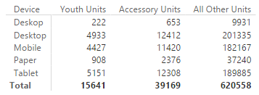
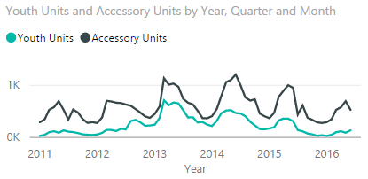
Module 4 Lab
Create a report for the VP in charge of the Youth and Accessory Segments
Include a table visualization showing total units sold in the Youth Segment, Accessory Segment, and all other segments; by Campaign Device
Include a line chart showing total units sold in Youth and Accessory Segments by month
BONUS: Use the Unit Cost and Unit Price from the ProductDim table to calculate Sales Amount, Cost of Goods Sold, Profit and build some visuals around them
Notes:
Expected results: users will need to create 3 measures to accomplish #1 and #2 :
- Youth Units Sold = CALCULATE([Total Units Sold],FILTER(ProductDim,ProductDim[Segment]="Youth"))
- Accessory Units Sold = CALCULATE([Total Units Sold],FILTER(ProductDim,ProductDim[Segment]="Accessory"))
- Rest of Company Units Sold = CALCULATE([Total Units Sold],FILTER(ALL(ProductDim),AND(ProductDim[Segment]<>"Accessory",ProductDim[Segment]<>"Youth")))
The visuals are a simple table and fairly straightforward line chart (be sure to use Date from DateDim)
For #3, users will need to create three measures :
Sales Amount M = SUMX(Sales, Sales[Units] * RELATED(ProductDim[Unit Price]))
COGS M = SUMX(Sales, Sales[Units] * RELATED(ProductDim[Unit Cost]))
Profit M = SUMX(Sales, Sales[Units] * (RELATED(ProductDim[Unit Price]) - RELATED(ProductDim[Unit Cost])))
alternatively, Profit M = [Sales Amount M] - [COGS M]
alternatively, users could accomplish this via calculated columns but this is not preferred.

Slide 106
KNOWLEDGE CHECK Module 4
What are the different kinds of evaluation contexts?
When are filter or a row contexts present?
Which functions are commonly used to modify existing evaluation contexts?

Slide 107
Module 5
Advanced DAX Time Intelligence Functions

Slide 108
MODULE OBJECTIVES
Be able to parse advanced DAX formulas (e.g., cumulative functions)
Gain familiarity with standard DAX patterns
Introduction to resources for further learning

Slide 109

Before we get to Time Intelligence - Let us apply all of the DAX techniques
Advanced DAX
[SalesYTD] =
CALCULATE (
[Total Sales],
FILTER (
ALL ( DateDim),
DateDim[Year] = MAX ( DateDim[Year] )
&& DateDim[Date] <= MAX(DateDim[Date])
)
)
Let us take a super complicated DAX statement and break it down and understand what it means
Notes:
Tab: Time Intelligence-YTD
Slides walk thru the logic – Follow the narrative of the next 5 slides

Slide 110
Before we get to Time Intelligence - Let us apply all of the DAX techniques
Advanced DAX
[SalesYTD] =
CALCULATE (
[Total Sales],
FILTER (
ALL ( DateDim),
DateDim[Year] = MAX ( DateDim[Year] )
&& DateDim[Date] <= MAX( DateDim[Date] )
)
)
In a CALCULATE statement Filter arguments are evaluated first
The Filter in this case comes from a FILTER function
FILTER function is an iterator

Slide 111
Let us apply all of the data modeling techniques
Advanced DAX
[SalesYTD] =
CALCULATE (
[Total Sales],
FILTER (
ALL ( DateDim),
DateDim[Year] = MAX ( DateDim[Year] )
&& DateDim[Date] <= MAX( DateDim[Date] )
)
)
In a FILTER statement the input Table is evaluated first
ALL statement means take all DateDim

Slide 112
Let us apply all of the data modeling techniques
Advanced DAX
[SalesYTD] =
CALCULATE (
[Total Sales],
FILTER (
ALL ( DateDim),
DateDim[Year] = MAX ( DateDim[Year] )
&& DateDim[Date] <= MAX(DateDim[Date] )
)
)
Iterate through each row in DateDim
Check for condition based on row context and filter context
Pro Tip: if you need to concatenate two conditions with an AND use && for and OR use ||

Slide 113
Let us apply all of data modeling techniques
Advanced DAX
[SalesYTD] =
CALCULATE (
[Total Sales],
FILTER (
ALL ( DateDim),
DateDim[Year] = MAX ( DateDim[Year] )
&& DateDim[Date] <= MAX(DateDim[Date] )
)
)
Now you have a FILTERED list of dates
Use this to update the filter context (since it is in a CALCULATE statement)

Slide 114
Let us apply all of the data modeling techniques
Advanced DAX
[SalesYTD] =
CALCULATE (
[Total Sales],
FILTER (
ALL ( DateDim),
DateDim[Year] = MAX ( DateDim[Year] )
&& DateDim[Date] <= MAX(DateDim[Date] )
)
)
Use updated FILTER context to evaluate ‘Total Sales’

Slide 115
Introducing Time Intelligence – There is an App for that!!
Advanced DAX – Time Intelligence
[SalesYTD Easier] =
CALCULATE (
[Total Sales],
DATESYTD(DateDim[Date])
)
This allows you to write the formula without being a DAX guru!
Microsoft is continuously improving Time Intelligence functions to make it simple to use
Time Intelligence functions are your friends – They will save you time!

Slide 116
Month Over Month
Advanced DAX – Time Intelligence
Total Sales Last Month =
CALCULATE([Total Sales],
PREVIOUSMONTH(DateDim[Date]))
MoM =
DIVIDE([Total Sales] - [Total Sales Last Month],
[Total Sales Last Month])
DAX has several shortcut Time Intelligence functions
Notes:
Additional calculations to discuss commonly used scenarios
Calculates based on same day in prior month
MoM – Month over Month

Slide 117
Monthly Active Users
Advanced DAX – Time Intelligence
[Monthly Active Users] =
CALCULATE(
SUMX(VALUES(Sales [CustomerId]),1),
ALL('DateDim'),
DATESINPERIOD('DateDim'[Date],
LASTDATE('DateDim'[Date]), -1, MONTH)
)
Sumx vs DistinctCount of CustomerID
SUMX can be more performant
Notes:
Another commonly used scenario
Calculates based on same day in prior month – Discuss usage of DATESINPERIOD and LASTDATE

Slide 118
Other Time Intelligence Functions
Advanced DAX – Time Intelligence
DATESINPERIOD
DATESYTD
DATESQTD
NEXTMONTH NEXTYEAR
PREVIOUSYEAR PREVIOUSMONTH SAMEPERIODLASTYEAR
PARALLELPERIOD
Pro Tip: Learn about Time Intelligence functions - https://msdn.microsoft.com/en-us/library/ee634763.aspx

Slide 119
KNOWLEDGE CHECK Module 5
Can I parse advanced DAX formulas?
What are some standard DAX patterns?
Which time intelligence functions are built-in to DAX?

Slide 120
Power BI Support Resources
Contact Support
Report Errors, Issues – Support.PowerBI.com
Resources use presentation mode to click the hyperlinks
Community.PowerBI.com – Community Forum
Data Stories Gallery – Get inspired with Data Stories by other Power BI users
R-Visuals Gallery – Get inspired by others use of R for analyzing their data
Visuals.PowerBI.com – Custom PBI visuals and R visuals you can download and use in your story
Power BI Blog - weekly updates
User Voice for Power BI – Vote on (or submit) your favorite new ideas for Power BI
Issues.PowerBI.Com – log issues with the community
Guided Learning Self Service Power BI training
DAX Formula Language – syntax for DAX
DAX Patterns – Great website to learn new patterns for the DAX Language
Power Query Formula Language – syntax for the “Query” language
Instructors:
Notes:
External Support Resources for Microsoft

Slide 121
Questions?

Slide 122
Appendix

Slide 123
KNOWLEDGE CHECK ANSWERS Module 1
What is a data model in the context of Power BI?
A data model is a collection of tables and relationships
What are some advantages of a star schema over a flat or denormalized model?
Dimension tables save space by reducing the amount of data that needs to be repeated over and over in every row
Relationships between tables can be leveraged for more complex measures
How might you improve the performance of a Power BI model?
Try using a star schema instead of a flat or denormalized model
Remove unnecessary columns
Set appropriate data types
How does Power BI store DateTime information? What are some consequences of this?
DateTime information is stored as a floating-point decimal number. This means that datetimes are very precise but not very efficient to store.

Slide 124
KNOWLEDGE CHECK ANSWERS Module 2
When is Calculated Column Evaluated?
At the time of data load/data refresh.
What is Default Summarization?
A default summarization is an implicit measure created in the background when you put a numeric field on a visualization. The function used (sum/max/min/avg/…) is based on the numeric field’s default summarization setting.
When is a Measure Evaluated?
At render time.
When to use Measures and Calculated Columns?
It depends ☺. Calculated columns are useful when each row of data should be independently considered (although measures can do this too!) and the result won’t change until the next data refresh. Measures should be used everywhere else.

Slide 125
KNOWLEDGE CHECK ANSWERS Module 4
What are the different kinds of evaluation contexts?
Filter context and row context
When are filter or a row contexts present?
Row contexts are present in iterator functions and calculated column evaluations. Filter contexts are present in pivot tables and other visualizations.
Which functions are commonly used to modify existing evaluation contexts?
CALCULATE, ALL, etc.

Slide 126
KNOWLEDGE CHECK ANSWERS Module 5
Can I parse advanced DAX formulas?
Yes I can!
What are some standard DAX patterns?
CALCULATE(…)
Which time intelligence functions are built-in to DAX?
Lots of them…YTD, FY, previous month, etc

Slide 127

What is a Calculated Column?
DAX Foundations
Calculated Column
Pro Tip: Always refer to a calculated column by its full name -> TableName[ColumnName]
Notes:
Used to add attributes that don’t exist in the source data
See this formula. This looks a lot like Excel
Demo:
In Product Dim Table add the above formula from the Tab called “Calculated Column”

Slide 128

Calculated Column in DAX vs Custom Column in “Query Editor”
DAX Foundations
Note: If given a choice, creating the column in “M” or “Query Editor” will give you better compression.
Notes:
DEMO: If a question comes up related to how to create a calculated column in ”M”, then do the following:
Open Query editor and create a calculated column using this formula:
if [Unit Price] <= 25 then "Low" else if [Unit Price] <=50 then "Medium" else "High“ M is case sensitive and the if/then/else syntax is different than Excel/DAX
Instructor Talking Point, if needed:
Once the column comes in it becomes like any other column in Power BI Desktop file
The column is compressed
There is a secondary processing for Calculated Columns – Which makes process times slower

Slide 129

Calculated Column – Accessing columns from other Tables in model
DAX Foundations
Often you want to access columns from multiple tables to create a Calculated Columns
Let us say you want to calculate COGs, which is Units * Units Cost
Units Cost is in another Table

Slide 130


Row Context and Multiple Tables – RELATED Function
DAX Foundations
Sales[COGS] = RELATED(ProductDim[Unit Cost]) * Sales[Units]
RELATED is just like VLOOKUP in Excel
Notes:
First Bring in the column. Let it resolve and then multiply
Demo:
In SalesFact Table write this formula: Sales[COGS] = RELATED(ProductDim[Unit Cost]) * Sales[Units]
(also available in Calculated Column Tab)
Note to instructor: Just like Vlookup but without all of the drama – No NA()

Slide 131

RELATED Function Example
DAX Foundations
You could follow a chain of relationship from Many side to 1 side using RELATED
Sales [City State]= RELATED(GeographyDim[City]) & “, ” & RELATED(GeographyDim[State])
Notes:
This is an example of “Just because you can, does not mean you should”
Creating a calculated column like this on the fact table takes way too much memory when it could just as easily be placed on the GeographyDim table.
No Demo on this slide
Note to Instructor: If you need to aggregate back from 1 side to the Many side, there is a companion formula called RelatedTable – but we will cover that later.

Slide 132
When is a Calculated Column Evaluated?
DAX Foundations
“Get Data” Phase
Model Creation Phase
Model
Enhancement
Phase
Visual
Building Phase
Create Query in “M”
Compress data
Auto detect relationships
Add calc. columns, Measures
Add missing relationships
Evaluate Measures and build each visual
Notes:
Note to Instructor: This has already been covered and is just reinforcing a concept covered in a previous slide.

Slide 133
Best Practices with DAX Calculated Columns
DAX Foundations
Whenever possible, DAX helper columns should be avoided. Each “Helper Column” will consume RAM
Create a calculated column in the Dim Table as opposed to in the Fact Table
Move calculated columns to “M” if you can
Notes:
Instructor Talking Point,
Best Practice is to create a calculated column at the HIGHEST level of granularity - in the highest dim

Slide 134
DAX Foundations
Calculated Column
Measure
Notes:
Instructor Note: This is just a navigation slide

Slide 135
Calculated Measures

Slide 136
Why are Default Summarizations useful?
DAX Foundations
Don’t have to know DAX
Power BI Team is looking to add easier ways to perform calculations using “Quick Measures” and “Show Value As”
Notes:
Instructor Note: Nothing to demo. Slide is self explanatory
“Quick Calcs” has been renamed to “Show Value As”
“Quick Measures” are new in the April release

Slide 137

What is a Measure?
DAX Foundations
[Total Sales]=SUM(Sales[Sales Amount])
Measures are created using DAX
Place your Measures on a Fact table for best results
Pro Tip: When referring to a measure in other calculations, refer to it without a Table name: [MeasureName]
Notes:
DEMO:
From the Modeling Ribbon, show measure called Total Sales and that resolves to the same values as default summarization.
Formula: Total Sales = SUM(Sales[Sales Amount])
In the Measure tab, drop the Total Sales measure onto the graph on the right in the values section
Instructor Talking Points:
Explain the calculations in DAX vs Power BI:
On the graph on the top left, the calculations are done by Power BI implicitly.
The graph on the right, show the calculations on the right in DAX which are written, explicitly.
Instructor Note:
Talk about Home Tables. Even though it looks like Measures are in a Fact Table internally they are stored in a separate table called Measures Table
Always ensure the Home Table is a FACT table
Be sure the mention that measures should only be associated with FACT tables, and that measure names must be globally unique within the data model.
If class is interested, may be worth mentioning that the reason measure names must be unique is that they end up being associated with a hidden measures-only table that gets created in the data model

Slide 138
Measure, Use Case 1: Using One Measure in Another
DAX Foundations
Instead of writing this:
[Profit] = SUM(Sales[Sales Amount])-SUM(Sales[COGS])
Write this:
[Profit] = [Total Sales]- [Total COGS]
Allows re-use of measures
Formulas are much simpler to read
Notes:
Advantage to writing DAX
Simplify DAX by referencing other Measures
Quickly reference the list of measures from the formula bar by typing “[“ – As all Measures start with this character

Slide 139
Measure, Use Case 2: More Complex Calculations
DAX Foundations
[Profit Margin %] = [Profit] / [Total Sales]
Ratios are calculations that cannot be created using a Calculated Column or Default Summarization
Use DAX DIVIDE for built in error handling
[Profit Margin %] = DIVIDE([Profit] , [Total Sales])
Notes:
DEMO:
Profit Margin = Sales[Sales Amount] – Sales[Cogs]
Profit Margin % = DIVIDE([Profit Margin], Sum(Sales[COGS]) )

Slide 140
When is a Measure Evaluated?
DAX Foundations
“Get Data” Phase
Model Creation Phase
Model
Enhancement
Phase
Visual
Building Phase
Create Query in “M”
Compress data
auto detect relationships
Add calc. columns, Measures
Add missing relationships
Evaluate Measures and build each visual

